Slide 1
Backend Progress
Tim Li | Minke Yu

Slide 2
Backend Progress
Our goal for this semester is to build up some small games in foreign language for people to play and learn. e.g. card games with numbers ‘1,2,3,4...’ expressed in foreign language ‘一，二，三，四...’
We also implemented some agents for interactive games.

Slide 3
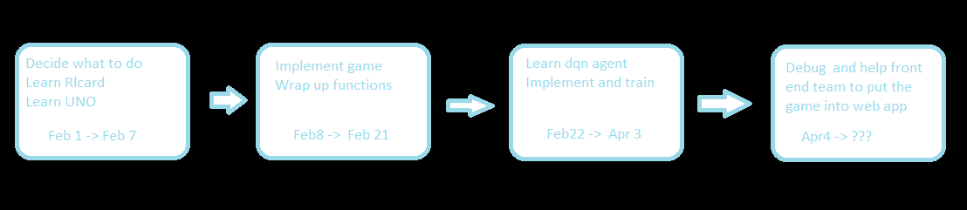
Mark Yu
UNO game
UNO deep-q learning AI
Resource:
Temporary repository: https://github.com/ymkymkymkymx/Some-useless-codes
http://rlcard.org/

Slide 4
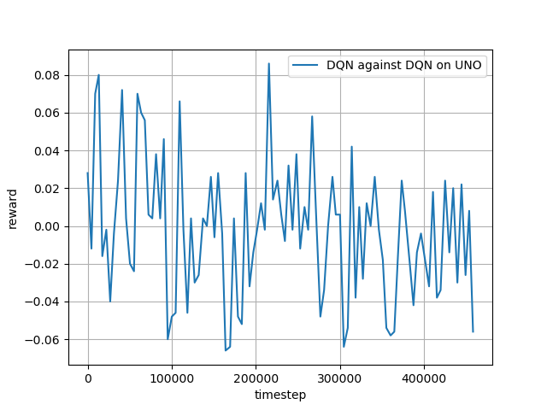
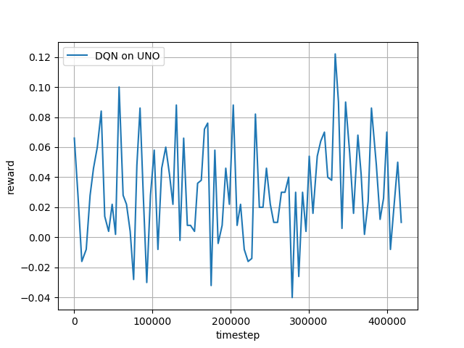
Some training graphs
Train two dqn agent against each other at the same time
Train dqn with random agent
Although intuitively the model of dqn against dqn should be stronger, when I put the two models against each other, model against random agent came out on top

